Slide 1
Artificial Intelligence
Lecture 6

Slide 2
Today’s Lecture
Constraint Satisfaction Problem
Backtracking Search

Slide 3
Constraint Satisfaction Problem
A constraint satisfaction problem (CSP) is a type of mathematical problem that involves a set of variables, each with a domain of possible values, and a set of constraints that define the allowable combinations of values for the variables.
The goal is to find an assignment of a value to each variable so that all constraints are satisfied.
CSPs are used in a wide variety of applications, from scheduling to logic puzzles, and are solved using algorithms like backtracking search.

Slide 4
Constraint Satisfaction Problem
Variables: These are the unknowns in the problem. For example, in the N-Queens problem, a variable could be the position of a queen on the board.
Domain: This is the set of all possible values that a variable can take. In the N-Queens problem, the domain for each queen would be the set of rows and columns where it can be placed.
Constraints: These are the rules that restrict the values variables can take. For instance, in N-Queens, a constraint is that no two queens can share the same row, column, or diagonal.

Slide 5
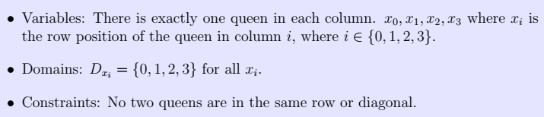
Formulating 4-Queens Problem as a CSP
We will make an assumption that there is exactly one queen each column.
Having assumed this, we no longer need to keep track of the column positions of the queens.
We also do not have to worry about the column constraints.

Slide 6
4-Queens Problem
For the 4-queens problem, we will use an incremental formulation, which means the state will be built step-by-step.
State: one queen per column in the leftmost k columns with no pair of queens attacking each other.
Initial state: no queens on the board.
Goal state: 4 queens on the board. No pair of queens are attacking each other.
Successor function: add a queen to the leftmost empty column such that it is not attacked by any other existing queen.

Slide 7
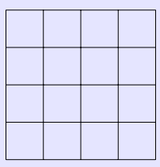
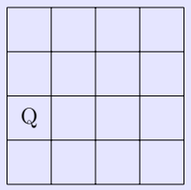
N-Queens as CSP Problem
The empty board is a valid state.
This is the state _ _ _ _.
We can add the first queen in row 2. This is the state 2 _ _ _.

Slide 8
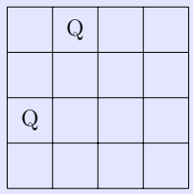
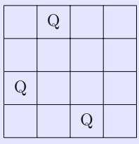
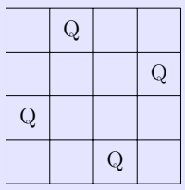
N-Queens as CSP Problem
Then we can add the second queen in row 0. This is the state 2 0 _ _ .
Then we can add the third queen in row 3. This is the state 2 0 3 _.
Finally, we can add the fourth queen in row 1. This is the state 2 0 3 1 .
We have now arrived at a goal state. None of the queens are attacking each other, and all 4 queens are on the board.

Slide 9
Backtracking Search
Backtracking search is a general algorithmic technique used to solve Constraint Satisfaction Problems (CSPs).
It is just a special type of DFS. We go deep into the tree until we hit a dead end or a solution.
It operates by systematically searching for a solution by incrementally building a candidate solution and abandoning ("backtracking") a partial candidate as soon as it determines that the candidate cannot possibly be completed to a valid solution.
If we hit a dead end, then we backtrack to the previous parent and try to explore the other successors of the parent.

Slide 10
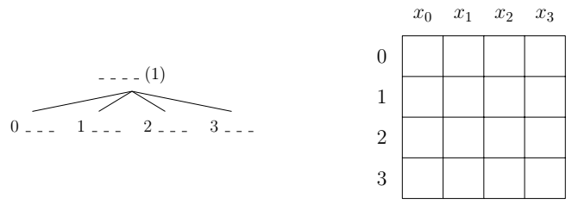
Backtracking Search
The initial state is the empty state, and it has 4 possible successors since there are 4 possible rows to put the first queen on the board.

Slide 11
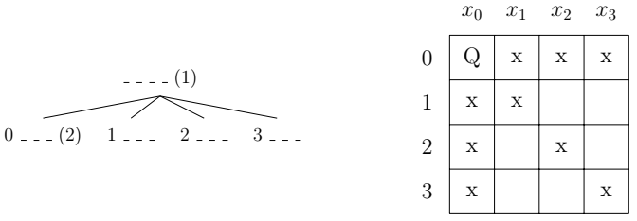
Backtracking Search
The next node to expand is 0.
We will add the queen to the board, and also cross out all the positions that the other queens cannot be in:

Slide 12
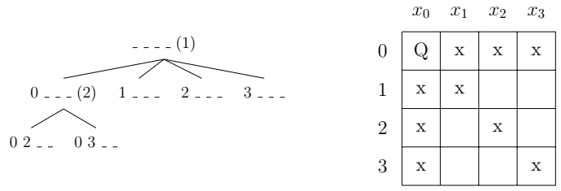
Backtracking Search
So the second queen can only be in row 2 or row 3, which means the state 0 has two successors.

Slide 13
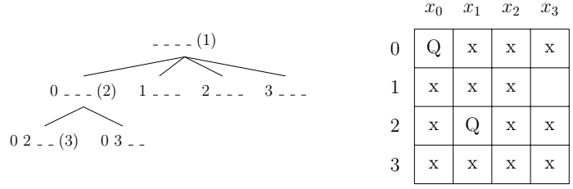
Backtracking Search
We expand state 0 2. We add the queen to the board, and also cross out all the positions that the other queens cannot be in.
Unfortunately, adding the second queen in row 2 has resulted in no possible positions for the third queen, and therefore there are no successors for the state 0 2.

Slide 14
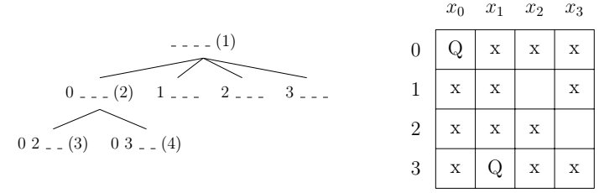
Backtracking Search
We need to backtrack to the parent node, and try the other successors of the parent node.
There is only one other successor of the parent node 0 and that is 0 3 , so we expand this state next.
We also cross out all the positions that the other queens cannot be in.

Slide 15
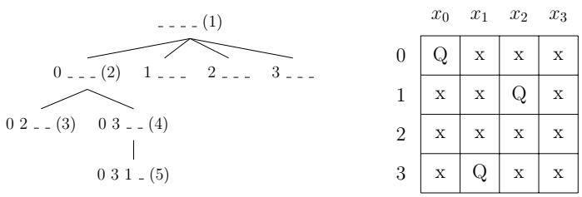
Backtracking Search
The third queen can only be in row 1.
We add the queen to the board, and also cross out all the positions that the remaining queens cannot be in.
Unfortunately, there is no possible position for the last queen, so the state 0 3 1 _ does not have a successor.

Slide 16
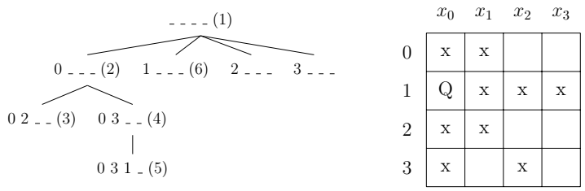
Backtracking Search
The search algorithm will backtrack all the way to the state _ _ _ _ and explore the next successor of that initial state, which is 1 _ _ _.

Slide 17
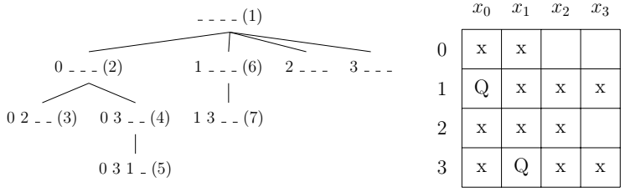
Backtracking Search
There is only one possible place for the second queen, which is in row 3.
We add the queen to the board, and also cross out all the positions that the remaining queens cannot be in:

Slide 18
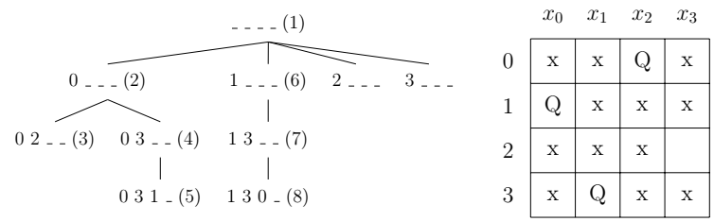
Backtracking Search
There is only one possible place for the third queen, which is in row 0.
We add the queen to the board, and also cross out all the positions that the remaining queens cannot be in.

Slide 19
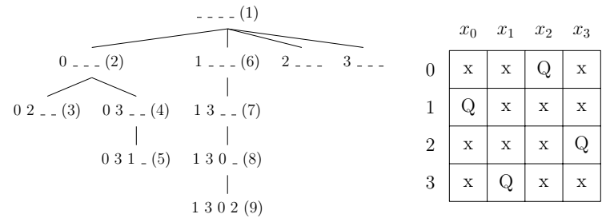
Backtracking Search
Finally, the only possible position for the last queen is in row 2. We add the queen to the board.
At this point, we’ve reached a goal node and we stop searching.

Slide 20
Today’s Lecture
Constraint Satisfaction Problem
Backtracking Search

